Slide 1


Slide 2

return

Slide 3

return

Slide 4
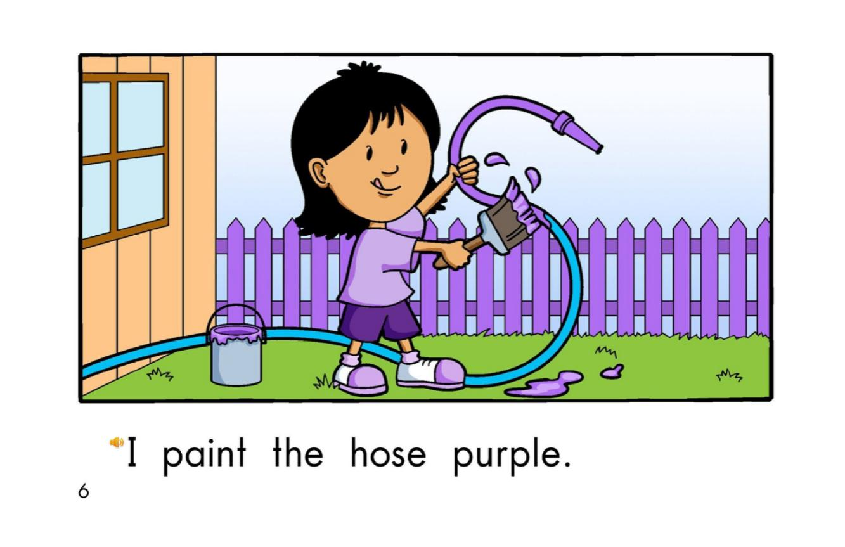
return

Slide 5

return

Slide 6

return

Slide 7

return

Slide 8
swing
fence
hose
shoes
grass
door
Click on the colored buttons to start getting to know them!

